Slide 1
Research Methods & Methodology
Tushar Kanti Patnaik
Scientist ‘F’

Slide 2
Outline
Introduction
Research methods
Research methodology
Differences & Types
Mixed methods
Summary & Conclusion

Slide 3
Introduction:
Research is an essential & powerful tool in leading mankind towards progress.
Scientific research leads to progress in the fields of life. New products , new facts , new concepts & new ways of doing things are being found due to ever increasing significant research in the physical , the biological , the social & the psychological fields.

Slide 4
Research
Broadest
Search For Knowledge

Slide 5
Research
Gathering Data Information and facts for advancement of knowledge
Performing Methodological study for answering specific questions

Slide 6
Types of reaserch
General /Basic research
Specific /Applied reaserch

Slide 7
Basic
It is designed to add an organized body of scientific knowledge and does not necessarily produce outcome of experiment result.

Slide 8
Applied research
Undertaken to solve immediate practical problem and to gain scientific knowledge is secondary goal

Slide 9
Types of research
Descriptive & Analytical
Qualitative & Quantitative
Experimental &Non Experimental
Conceptual and Emprical
Exploratory Research

Slide 10
Descriptive research
Descriptive Research is used for fact findings and enquiries for different things
There is no control for variables and one can only reports what has happened and what is happening

Slide 11
Analytical research
User have to use Facts/Information available to analyze critical information

Slide 12
Quantitive Research
It is based on Quantity OR Measurement of amount
It can be applied when there is a quantity of amount
Uses numbers and statistics to test theories and make predictions. It's often used to confirm hypotheses, identify patterns, and generalize results to larger populations. Quantitative research methods include surveys, experiments, and statistics

Slide 13


Slide 14
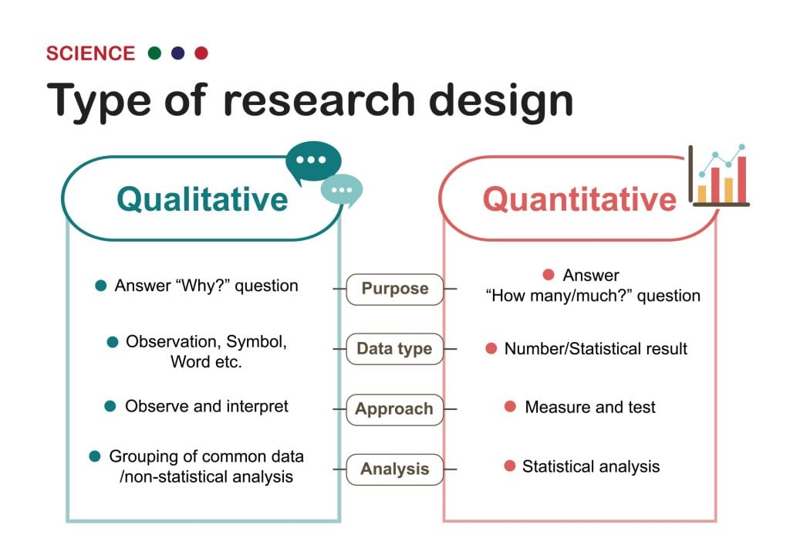

Slide 15
Qualitative research
It is specially important in the behavioral Science where the aim is to discover underlying motives of human behaviour

Slide 16
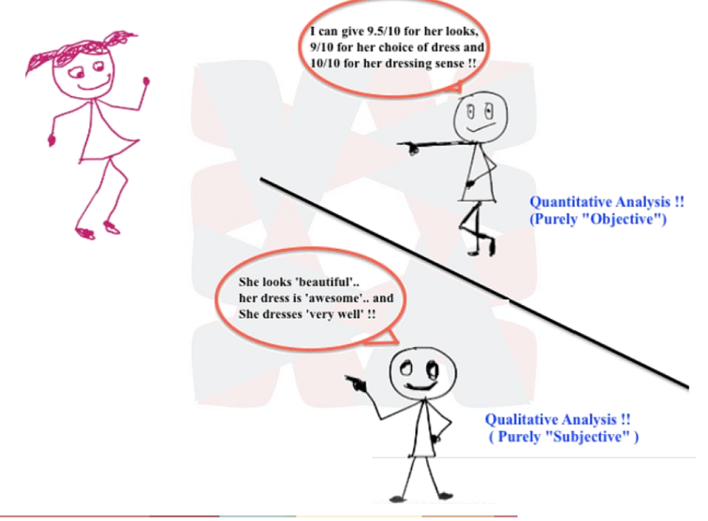

Slide 17
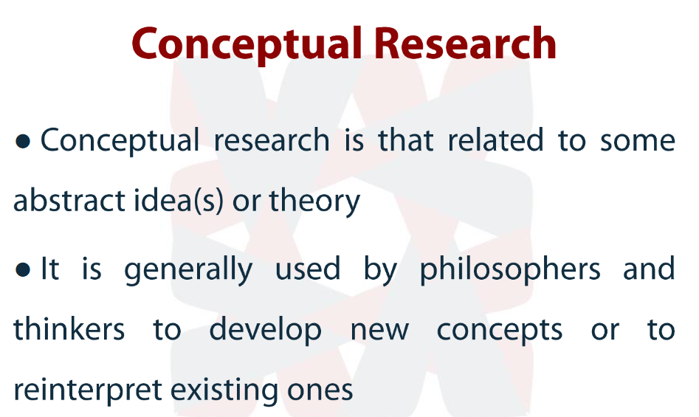

Slide 18
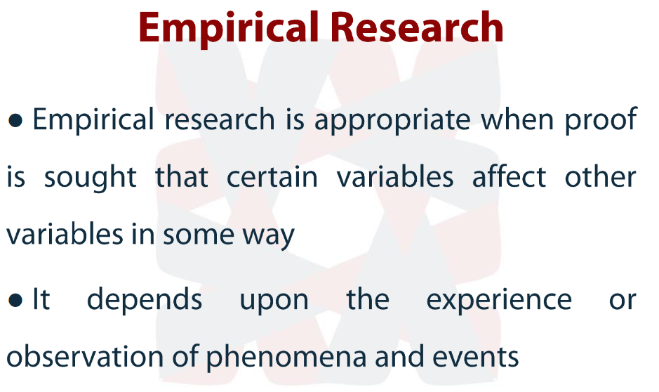

Slide 19
Empirical study uses qualitative or quantitative methods to conduct research and analyze results.
Quantitative research: Quantitative research is referred to as the process of collecting as well as analyzing numerical data. It is generally used to find patterns, averages, predictions, as well as cause-effect relationships between the variables being studied. It is also used to generalize the results of a particular study to the population in consideration
Qualitative research: Qualitative research can be defined as a method used for market research which aims at obtaining data through open-ended questions and conversations with the intended consumers. This method aims at establishing not only “what” people think but “how” they come to that opinion as well as “why” they think so.

Slide 20
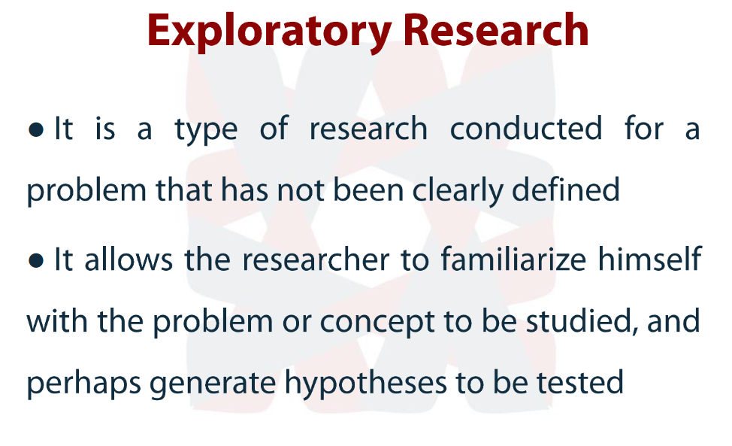

Slide 21
Exploratory research is research conducted to investigate a problem that is not clearly defined, has been under-investigated, or is otherwise poorly understood.
study that aims to understand why college students become addicted to their electronic devices.

Slide 22
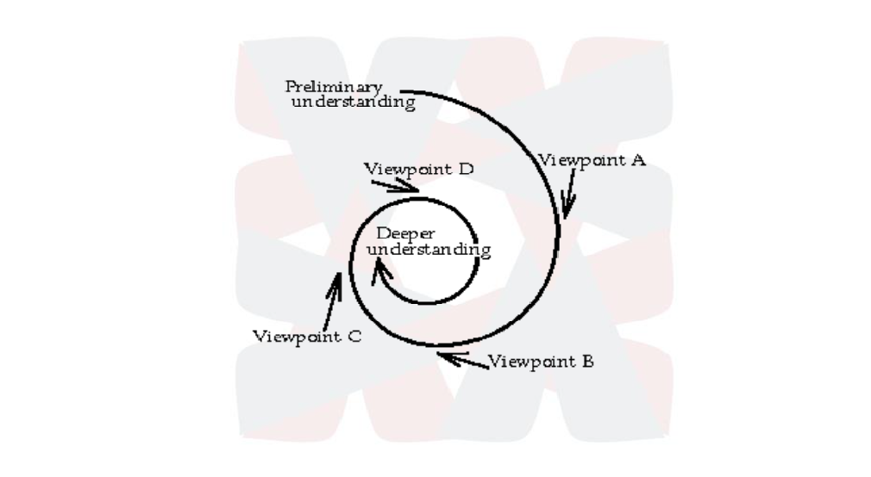

Slide 23
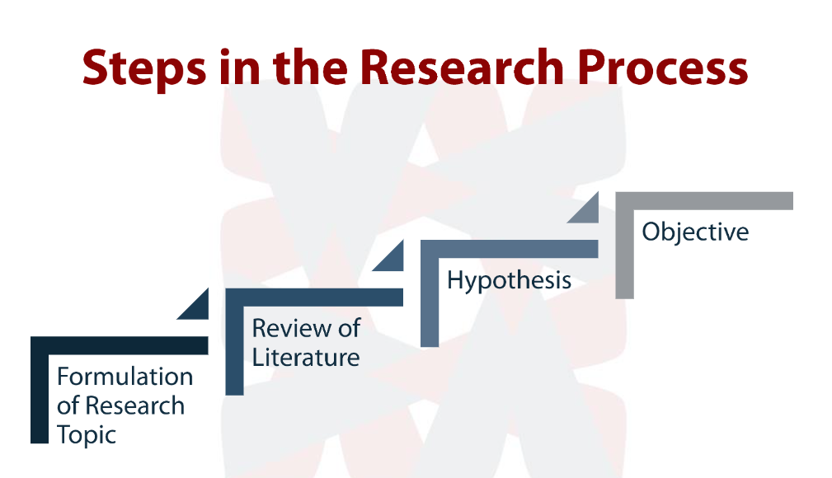

Slide 24
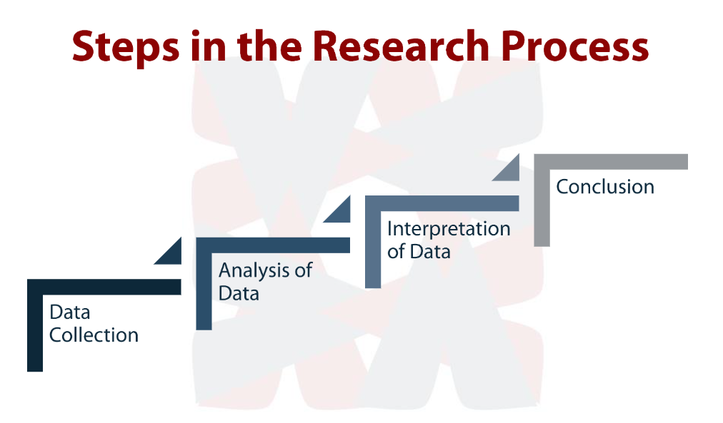

Slide 25
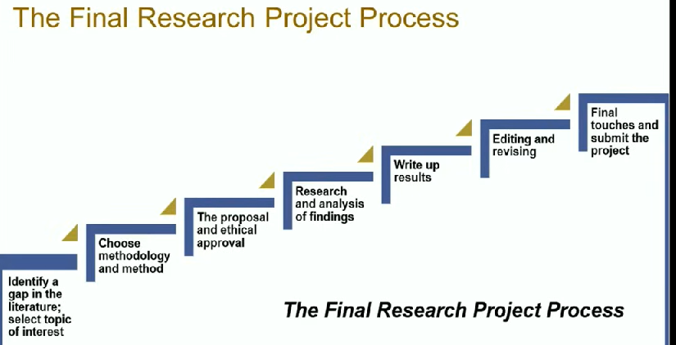

Slide 26
Research Methods Versus Methodology

Slide 27
Research Methods
Research methods may be understand as all those methods/techniques that are used for conduction of research.
Thus, it refers to the methods the researchers use in performing research operations.
All those methods which are used by the researcher during the course of studying his research problem are termed as research methods.

Slide 28
Research Methodology
Research methodology is a way to systematically solve the research problem. It may be understood as a science of studying how research is done scientifically.
In it we study the various steps that are generally adopted by a researcher in studying his research problem along with the logic behind them.
Evaluation of research methods is called as research methodology.

Slide 29
Methods
While writing the methods section you must remember the following:
Authors must duly cite all sources that helped them in selecting the methods for the research study. Furthermore, it should also include parameters of past studies must to indicate relevance with the current study.
It is mandatory to cite the sources of all participants of the study. The details of participants such as geographical location, age, sex, their initial conditions, etc. must be mentioned in the methods section.
The methods section must also include the inclusion and exclusion criteria of subjects.
Description of division of chosen group and their characteristics is also an element of the methods section.
The methods section must also include the study design. Necessary preparations, software used, and instruments must be explained here.
Finally, it must include statistical analyses. For example: type of data, their measurements, and statistical tests.

Slide 30
Categories of research methods:
-First Category : The methods relating to data collection . These are used when the existing data is not sufficient , to reach the solution.
Second Category : Process of analyzing data ; i.e. to identify patterns & establish a relationship between data and unknowns.
Third category : Comprise of the methods which are used to check the accuracy of the results obtained.

Slide 31
Types of Research Methods :
Methods are the specific approach to collecting the data.
- Interviews
- Surveys
- Focus groups
- Experiments
- Case studies
- Observational studies
- On-line data collection

Slide 32
Research Methodology :
It is the study of methods , so as to solve the research problem.
Science of learning the way research should be performed systematically.
Refers to rigorous analysis of the methods applied in the stream of research ; to ensure that the conclusions drawn are valid , reliable & credible too.
The system of collecting data for research projects is known as research methodology.

Slide 33
Cont…
Research methodology is a guide to research & how it is conducted.
It describes & analysis methods, throws more light on their limitations & resources ; clarify their pre-suppositions & consequences , relating to their potentialities to the twilight zone at the frontiers of knowledge.

Slide 34

Philosophies of Methodology:
Phenomenology : Phenomenological research is a qualitative research approach that builds on the assumption that the universal essence of anything ultimately depends on how its audience experiences it.
Phenomenological researchers record and analyze the beliefs, feelings, and perceptions of the audience they’re looking to study in relation to the thing being studied. Only the audience’s views matter—the people who have experienced the phenomenon. The researcher’s personal assumptions and perceptions about the phenomenon should be irrelevant..
Critical Theory : Strands of critical theory exists in terms of criticism of occidental complacency & that ruling elites & ideologies should be challenged as well as greater equality & liberty sought.
Ethnography : Research is undertaken in the field & attempts to capture & understand social action and the meaning of this action. The researcher is not based in a constructed setting or experiments but part of the everyday natural situation within which those under investigation (or those involved with research project) .

Slide 35
Cont…
Survey : Used to obtain data about practices, situation views at one point in time through questionnaire or interviews. Can be conducted by paper- based / web- based.
Case – study : Data collection at one or several sites ,- over a period of time – data is usually obtained from “multiple source of evidence” including interviews & documents.
Laboratory Experiment : Aim to control over independent variables being measured. Random assignments of subjects.

Slide 36

Cont…
Field experiment : Conducted within a naturally occurring system. Here, don’t have control over variables under measurement.
Action Research : Aim to solve a practical problem.
- Reflective process of progressive problem solving led by individuals working with others in teams or as part of a “community of practice”.

Slide 37
Cont…
Simulations : - Copying the behavior of a system.
- Used in situations where the introduction of random variables.
- It has a problem of making the data collected sufficient enough to resemble reality.
Subjective / argumentative research : Used for generating new theories & ideas which can subsequently be tested. It is subject to research bias . It is unstructured & subjective form of research.

Slide 38
RELATIONSHIP BETWEEN & ETHODOLOGY & METHODS
Methodology is the general research strategy that outlines the way in which a research project is to be undertaken , & among other things, identifies the methods to be used in it. These methods , described in the methodology , define the means or modes of data collection or sometimes , how a specific result is to be calculated. Methodology does not define specific methods , even though much attention is given to the nature & kinds of processes to be followed in a particular procedure or to attain an objective. Any description of a means of calculation of a specific result is always a description of a method & never a description of a methodology. It is thus important to avoid using methodology as a synonym for method or body of methods.

Slide 39
Advantages of Research Methodology :
1) Advancement of wealth of human being.
2) Provision of tools for carrying out the research.
3) Develops a critical & scientific attitude , disciplined thinking to observations.

Slide 40
Cont..
4) Enrichment of the research process & provision of chance for in- depth study & understanding of the subject.
5) Helps to inculcate the ability to evaluate & use research results with reasonable confidence and in decision – making.
6) Inculcates the ability to learn to read and think critically.

Slide 41
Comparison b/w methods & methodology :
Basis of Comparison | Research Method | Research Methodology
Meaning | Implies the methods employed by the researcher to conduct research. | Research methodology signifies way to efficiently solving research problems.
What is it ? | Behavior & instrument used in the selection of the research technique. | Science of understanding , how research is performed methodically.
Encompasses | Carrying out experiment , test , surveys & so on. | Study different techniques which can be utilized in the performance of experiment , test , surveys etc.

Slide 42
Cont…
Basis of Comparison | Research Method | Research Methodology
Comprise of | Different investigation techniques | Entire strategy towards achievement of objectives
Objective | To discover solution to research problem | To apply correct procedures so as to determine solutions.

Slide 43
Research Methodologies :
Research Methodologies
Quantitative Methodology Qualitative Methodology

Slide 44
Difference Between Research Methods and Methodology
Research Method | Research Methodology
The scope is lesser than research methodology | The scope is very wider than research methods
It is part of research methodology | It has many dimension
Research method seeks to answer: what did the researcher use to complete his research. | Research methodology seeks to answer: how did the researcher complete his study.
Research methods are the techniques and tools by which you research a subject or a topic. | Methodology explains and justifies the techniques and tools by which you may proceed with your research.
Research methods involve the tasks of conducting experiments, tests, surveys, and the like utilizing the knowledge and skills learned through research methodology. | Research methodology involves the learning of various techniques to conduct research and acquiring knowledge to perform tests, experiments, surveys, and critical analysis.
The research method aims at finding solutions to research problems. | Research methodology ensures the employment of the correct procedures to solve the problems.
Research methods are the end of any scientific or non-scientific research. | Research methodology paves the way to choose appropriate research methods and thus is the beginning of any research.

Slide 45
Research Methods & Methodology :
Research Methods :
- methods by which the researcher conduct research into a subject or a topic.
- Involve experiments , tests , surveys ….
- Research method pertains to all those methods which a researcher employs to undertake research process, to solve the given research problem. The techniques & procedure , that are applied during the course of studying research problem are known as the research method. It encompasses both qualitative & quantitative method of performing research operations , such as survey , case study , questionnaire , observation etc.

Slide 46
Qualitative Methodology
Depends on observations & descriptions.
Subjective , descriptive & no facts .
Concerned with quality.
Non-numerical , applies reasoning & uses words.
Aim is to get the meaning , feeling & describe the situation.
Contexts of inquiry are not contrived ; they are natural . Nothing is predefined or taken for granted.
Interactive process.

Slide 47
Qualitative research methodologies
Ethnography : - Anthropological approach.
- Allows the researcher to embed himself/ herself in the natural setting of the subject he / she tries to study.
- The researcher immersed in the living the lives just like the subject being studied experiencing & interfacing with them.
-Ex. Tribal hamlet – living & researching the people inhabiting them , their customs & traditions etc.

Slide 48
Cont..
Grounded Theory :
- Makes use of the research data to the tee.
Instead of drawing on theory at the beginning of the research , this approach derives theory from the data collected through research . The theory is grounded in the data.
Phenomenology :
- Studies ‘phenomena’ or ‘manifestations’ of things.
- It studies a particular phenomena, in its many angles & facets , adding to knowledge about the phenomena.
- Ex. Researching on the phenomenon of lightening , you look at information that you could access on lightening as it is experienced.

Slide 49
Cont…
Case Study :
- Tries to study unit of any subject.
- It tries to bring together all aspects & information about the unit under the study , contributing to explaining or describing something .
Ex. Case study on some institutions, disease case.
Narrative analysis :
- It weaves together a sequence of events , usually from just one or two individuals to form cohesive story.

Slide 50
Methods of data collection in qualitative methodology :
Interviews :
- Most common qualitative methods.
- Access to individual & personal narratives & responses.
- Serve as the conduit to rich data → provides in – depth personal reflections.

Slide 51
Focus –group discussion:
- Indulge a group of interviewees & respondents by posing questions that are then subject to discussion by the group.
- The dynamics in the group , debates , opinions & responses allow for “networked” answers to the questions posed , allowing the researcher to map them.

Slide 52
Cont…
Participant Observation:
- Entails the researcher embedding himself or herself in a group setting & observing intently to note down nuanced descriptions of the setting under study.
Ex. – descriptions of individual
- dynamics in a group.
- individual opinions.
Content analysis : Content analysis of documents or videos provides for a close reading of such articles. It allows the examination of how words , figures , pictures & texts deliver meaning, & offer explications of cultures. It yields codes & categories upon being subject to rigorous analysis.

Slide 53
Differences in 5 qualitative methods
Method | Focus | Sample size | Data collection
Ethnography | Context or culture | - -------- | Observation & Interviews
Narrative | Individual experience & sequence | 1-2 | Stories from individuals & documents
Phenomenological | People who have experienced a phenomena | 5-25 | Interviews
Grounded Theory | Develop a theory from grounded in field data | 20-60 | Interviews , open & axial coding
Case study | Organization, entity , individual or event | ---------- | Interviews , documents , reports & observation

Slide 54

Strengths of Qualitative Methodology:
Researcher gains an insider’s view of the field.
Play important role of suggesting possible relationships , causes , effects & dynamic processes.
Adds flesh & blood to social analysis.

Slide 55
Limitations :
Problem of adequate validity or reliability.
Contexts , situations , events , conditions & interactions can’t be replicated to any extent nor can generalizations be made to a wider context than the one studied with any confidence.
Time consuming
Researcher’s presence has a profound effect on the subjects of study.
Issues of anonymity & confidentiality present problems when selecting findings.
Chances for bias are more.

Slide 56
Quantitative research methods
Data can be analyzed in terms of numbers.
Based on original plans & its results are readily analyzed & interpreted.
Collection & analysis of data in numeric form.
Large samples are required.
More vulnerable to statistical error.
Misuse of sampling and weighting can undermine the accuracy , validity & project ability.

Slide 57
Key characteristics of Quantitative Research methods:
Control: - Enables the researcher to identify the causes of his or her observations.
- Control is necessary in order to provide unambiguous answers to questions.
- Control helps to isolate Cause & Effect.
2) Operational Definition:
- Terms must be defined by the steps or operations used to measure them.
- Eliminates confusion in meaning & communication.

Slide 58
Cont…
Replication : To be replicable , the data obtained in an experiment must be reliable ; i.e. the same result must be found if the study is repeated. If observations are not repeatable , our descriptions & explanations are thought to be unreliable.

Slide 59
Strengths of Quantitative Methodology
Precision : Through quantitative & reliable measurement.
Control: Through sampling & design
Ability to produce causality data , through the sue of controlled experiments.
Statistical techniques allow for sophisticated analyses.
Replicable.

Slide 60
Quantitative research methods :
Deductive approach.
Generally involves collecting numerical data that can be subjected to statistical analysis.
Ex. – Performance Tests
- Personality Measures
-Questionnaires (closed ended & open ended )
- Content analysis

Slide 61
Limitations:
Because of the complexity of human experience it is difficult to rule out or control all the variables.
Its mechanistic ethos tends to exclude notions of freedom , choice & moral responsibility.
Quantification can become an end in itself.
It fails to take account of people’s unique ability to interpret their experiences , construct their own meanings and act on these.

Slide 62
5) It leads to the assumption that facts are true & the same for all people all of the time.
6) Quantitative research often produces banal & trivial findings of little consequence due to the restriction on & the controlling of variables.
7) It is not totally objective because the researcher is subjectively involved in the very choice of problem as worthy of investigation & in the interpretation of the results.
8) The type of research & the format of research findings are limitations as well.

Slide 63
Mixed Methods
A mixed methods research is a procedure for collecting, analyzing & “mixing” both quantitative research & qualitative research and methods in a single study to understand a research problem.

Slide 64
Step V
Collect quantitative & qualitative data
Step IV
Develop quantitative , qualitative & mixed methods questions
Step III
Identify the data collection strategy & type of design
Priority
Sequence
Visualization
Step VI
Analyze data separately or concurrently
Step II
Identify a rationale for a mixed methods study
Step VII
Write the report as a one-or – two phase study
Step 1
Determine if a mixed study is feasible

Slide 65
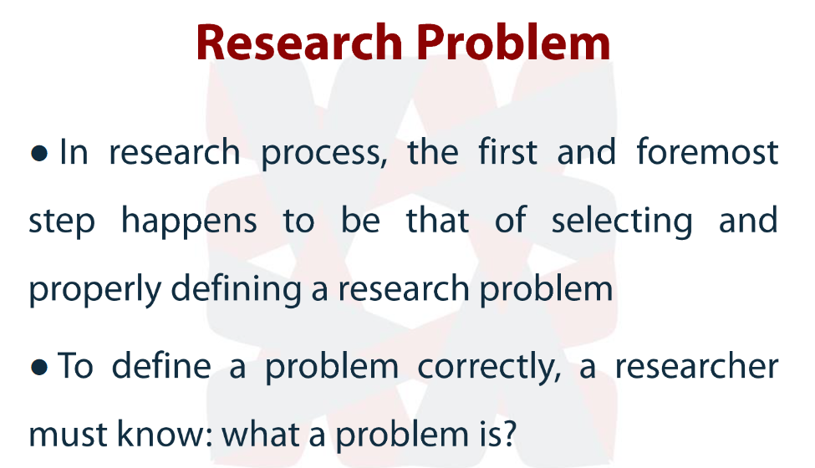

Slide 66
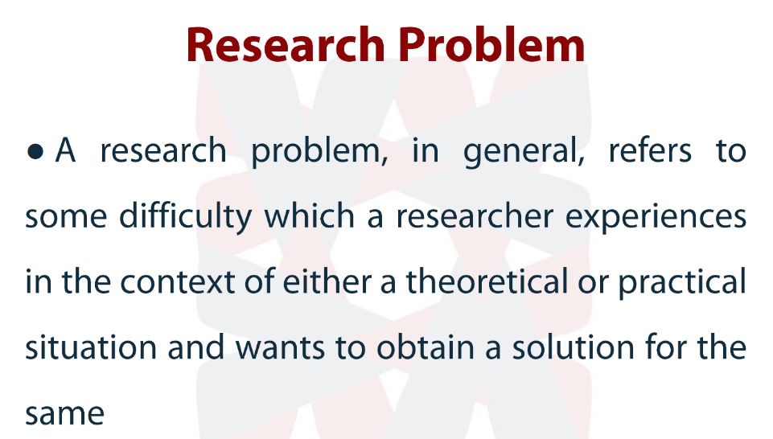

Slide 67
Defining problem is a first step to the research problem
Defining Problem Researcher need to set certain boundaries within which he has to study the problem with a pre defined objective in mind
Defining a problem is a difficult task and this must be done intelligently to avoid confusion that happens during research operation

Slide 68
State the Problem in a General way
Understand the nature of problem
Survey the available litreture
Go for discussions for generating ideas
Refresh the research problemin to working proposotion

Slide 69
State the problem in a general way
Study related subject thouroghly
Do the preliminary survey or plot the survey
Do People take interest in negative talk than positive talk?
Narrow down the by rethinking over the problem in a operational way
Do people see robbery ,or violence news than economic growth news?

Slide 70
Understand the nature of the problem
The reasercher need to discuss the problem in order to find origin of the problem
Nature objective subject matter to the problem is very much important

Slide 71
Survey the Problem
Survey the problem to
Narrow down the objective
Finding out possible outcome and deliverables
Identifying the research Gaps
Helps for Research Design

Slide 72
Rephrase problem statements into working proposition
Initial research question why Japan has more productivity than India
After problem is understood understanding the literature have been taken place
Then discussions took place to to jump into more depth and research gaps found out
Question Rephrased to
What factors are responsible for higher productivity in japan than India during the year 1971 to 1980

Slide 73
Sum up
When we talk of research methodology we not only talk about research methods but also consider the logic behind the methods we use in the context of our research study and explain why we are using a particular method and why we are not using others so that research results are capable of being evaluated either by the researcher himself or by others

Slide 74
What we do in Research?
Research-
defining and redefining problems, formulating hypothesis/objectives;
collecting, organizing and evaluating data;
making deductions and reaching conclusions;
testing the conclusions to determine whether they fit the formulating hypothesis/objectives

Slide 75
Research may have certain other qualities
a) It is a prearranged / structured enquiry (a formal step by step method or sequence to take up research activity is developed to ensure correctness of data and validity of processes).
Scientific methods consist of systematic observation, classification and interpretation of data. The degree of formality, rigorousness, verifiability and general validity of scientific methods establish the results obtained.
b) It utilizes acceptable scientific methodology to solve problems (the method used should be able to give repetitive results under similar conditions)
c) It should create new knowledge that is generally applicable. (The outcomes should be such that they are not specific to particular issue or a situation but need to be generalized for application to comparable issues).
d) It findings in developing new policies or applications of findings of a research in the benefit of public

Slide 76
Indications to use mixed methods
When both quantitative and qualitative data, together, provide a better understanding of your research problem than either type by itself.
When one type of research (qualitative or quantitative) is not enough to address the research problem or answer the research questions.
Pragmatism –practicality; multiple view points; biased and unbiased; subjective and objective.

Slide 77
Cont…
To incorporate a qualitative component into an otherwise quantitative study.
To build from one phase of a study to another.
Explore qualitatively then develop an instrument.
Follow-up a quantitative study qualitatively to obtain more detailed information.

Slide 78
Mixed method methodology
Utilizes both quantitative and qualitative data collection methodologies.
Examples:
-Interviews and Questionnaires
-Performance Tests and Observation
-Questionnaires and follow up Focus groups
-Document analysis, Performance Tests, Questionnaire, and Interviews.

Slide 79
Major Mixed Methods :
1. The Convergent Parallel Design :
Quantitative Data Collection & analysis
Compare or relate
Interpretation
Qualitative Data collection & Analysis

Slide 80
The Convergent Design
- The researcher:
Collects quantitative and qualitative data concurrently.
Analyzes the two data sets separately.
Mixes the two databases by merging the results during interpretation (and sometimes during data analysis).

Slide 81
The Explanatory Sequential Methods
Quantitative Data collection & analysis
Qualitative Data collection & analysis
Interpretation
Follow up

